Slide 1
Protein and Amino Acid Catabolism and the Urea Cycle

Slide 2
Quiz Question #1
When amino acids are fully metabolized what are the end products?
Glutamate, NADH, Water
Ammonia, NADH, Alanine
Urea, NADH, Glutamate
Water, CO2, Urea

Slide 3
Quiz Question #2
What is the function of the urea cycle?
Removal of carbon from glutamate
Conversion of CO2 into bicarbonate
Conversion of ammonia into urea
Production of urea for amination reactions

Slide 4
Quiz Question #3
Which of the following is a ketogenic amino acid
Alanine
Lysine
Glycine
Glutamate

Slide 5
Learning Objectives
Evaluate the signals that lead to protein degradation and how those signals activate proteolysis and autophagy.
Explain the circumstances by which amino acids and proteins would be degraded.
Describe the fates of the carbon skeletons when amino acids are catabolized.
Consider the importance of branched chain amino acids, and describe the regulation of branched-chain ketoacid dehydrogenase.
Explain the key role, and the mechanisms of regulation of Glutamate Dehydrogenase in amino acid catabolism.
Describe the role of the urea cycle and analyse how defects in the urea cycle could be detected and treated.

Slide 6
Two main mechanisms of protein breakdown
Proteolysis
Lysosome/Autophagy
Mediated by proteasome
Regulated by insulin inactivation of FOXO
Proteins marked by ubiquitinylation
Regulated by inactivation of mTORC1
Traffics proteins/organelles to lysosome for degradation
Notes:
2004 nobel prize
2016 nobel prize
mention targetted vs bulk degradation

Slide 7
Why Break Down Proteins into Amino Acids
Endocrine signals
Nutritional signals
Hormone | Effects on Protein Synthesis | Effects on Protein Degradation
Insulin | Promotes | Blocks
Glucocorticoids | Blocks | Promotes
Growth Hormone/IGF1 | Promotes | Blocks
Testosterone | Promotes | Blocks
Via mTORC1
Low energy
Low intracellular Leu, Lys, Arg
Notes:
Slow down and mention mTORC1 is central to both of these. Processes don’t matter but the

Slide 8
The Amino Acid Pool

Slide 9
Components of Amino Acid Degradation
Fates of the Carbon Skeleton
Fates of the Amino Group
Notes:
talk about energy here

Slide 10
Most amino acids are degraded by aminotransferases
Substrates |  | Enzyme | Products
Pyruvate | Glutamate | ALT | Alanine | α-Ketoglutarate
Oxaloacetate | Glutamate | AST | Aspartate | α-Ketoglutarate

Slide 11
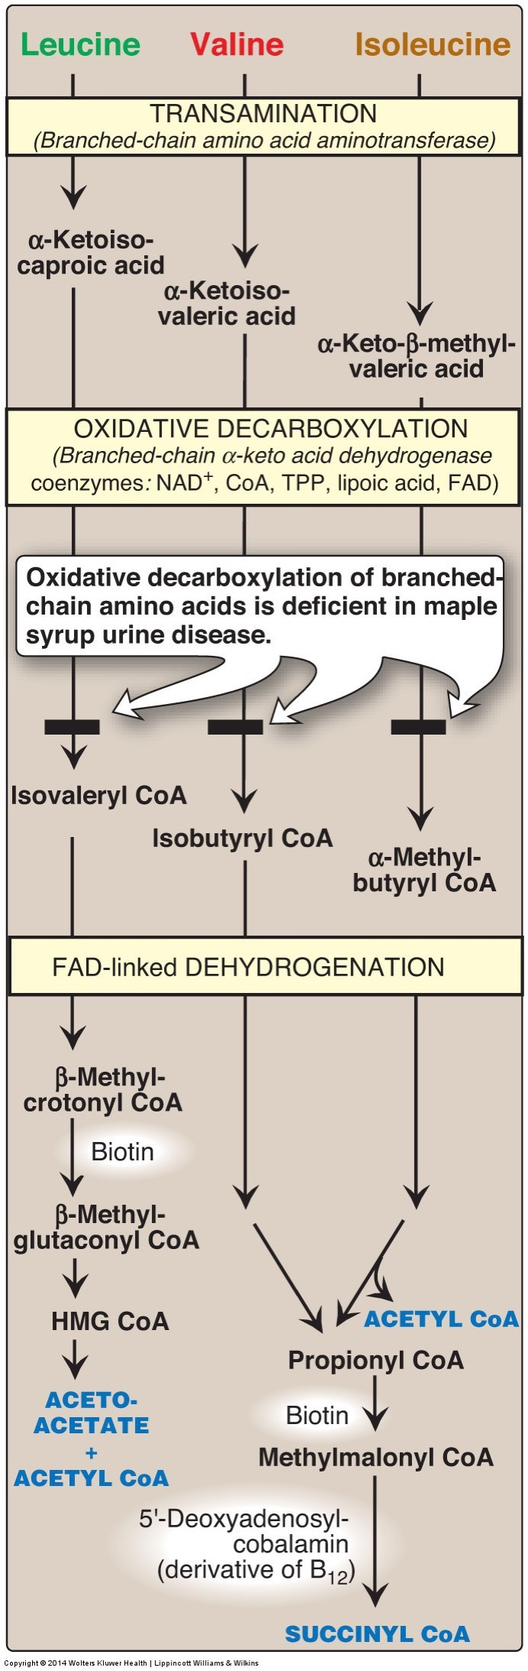
BCAA’s start with a transamination
Substrates |  | Enzyme | Products
Alanine | α-Ketoglutarate | ALT | Pyruvate | Glutatmate
Aspartate | α-Ketoglutarate | AST | Oxaloacetate | Glutatmate
Leucine | α-Ketoglutarate | BCAT | α-Ketoisocaproate | Glutatmate
Valine | α-Ketoglutarate | BCAT | α-Ketoisovalerate | Glutatmate
Isoleucine | α-Ketoglutarate | BCAT | α-Ketomethylvalerate | Glutatmate

Slide 12
Why are BCAA’s Important in Nutrition?
These three amino acids are a major constituent of total protein
~20% of all amino acids in protein
~35% of all indispensable amino acids in protein
There is a low amount of free BCAA’s in tissue
Of the 3-5g/kg of free AA in tissue, only ~0.1g are BCAA
Defects can lead to Maple syrup urine disease
Notes:
Of the 3-5 g/kg in tissue only ~0.1g are

Slide 13
More BCAA Catabolism
Leu/Val/Ile all use same BCAT/BCKDH steps
Next Step is Controlled by BCKDH
BCKDH is inhibited by protein phosphorylation
Activated by ketoisocaproic acid

Slide 14
Regulation of Branched Chain Ketoacid Dehydrogenase
A buildup of branched ketocacids (mainly α-Ketoisocaproate)
Inactivation of BCKDH kinase
Activation of BCKDH
More breakdown of branched ketoacids

Slide 15
Maple Syrup Urine Disease
Mutations in BCKDH subunits, so impaired BCAA breakdown
Autosomal recessive, 1 in 185 000 (1 in 380 in some Mennonite populations)
Treatment
Careful monitoring of Ile, Val, Leu levels in blood
Avoidance of protein catabolism (sufficient calories)
Potential liver transplantation
Think about how you could manage this nutritionally
Notes:
Ile/Val/Leu are still essential
Most foods are high in these
Smell
Weight loss, loss of appetite
Neurological development/seizures
lethargy

Slide 16
The rest of BCAA metabolism has several steps

Slide 17
Which amino acid(s) are ketogenic?
Leucine
Isoleucine, Valine
Valine
All of the above
Notes:
So what are the possible fates of Acetyl CoA

Slide 18
Nitrogen rich amino acids
Glutamine and Asparagine have 2 amide groups

Slide 19
Glutaminase Breaks Down Glutamine into Glutamate, releasing Ammonia
+ADP
Masola B, Ngubane NP. The activity of phosphate-dependent glutaminase from the rat small intestine is modulated by ADP and is dependent on integrity of mitochondria. Arch Biochem Biophys 2010; 504:197–203.

Slide 20
Asparaginase Breaks Down Asparagine to Aspartate
Which Enzyme Would Control the Next Step of Asparagine Breakdown?
Glutaminase
Aspartate Transaminase
Alanine Transaminase
Branched Chain Aminotransferase
Think about what would regulate this step

Slide 21
Back to the transaminases…
Substrates |  | Enzyme | Products
Alanine | α-Ketoglutarate | ALT | Pyruvate | Glutamate
Aspartate | α-Ketoglutarate | AST | Oxaloacetate | Glutamate
Leucine | α-Ketoglutarate | BCAT | α-Ketoisocaproate | Glutamate
Valine | α-Ketoglutarate | BCAT | α-Ketoisovalerate | Glutamate
Isoleucine | α-Ketoglutarate | BCAT | α-Ketomethylvalerate | Glutamate
Tyrosine | α-Ketoglutarate | TAT | 4-hydroxyphenylpyruvate | Glutamate
Tryptophan | α-Ketoglutarate | TTA | (indol-3-yl)pyruvate | Glutamate
Methionine | α-Ketoglutarate | MAT | 2-oxo-4-methylthiobutanoate | Glutamate
Cysteine | α-Ketoglutarate | CT | Sulfinylpyruvate | Glutamate

Slide 22
Many Degradation Paths Lead Through Glutamate
Transaminases
Alanine (also makes pyruvate)
Aspartate (also makes oxaloacetate)
Asparagine (via Aspartate)
Leucine, Valine, Isoleucine (also makes branched ketoacids)
Tyrosine, Tryptophan, Methionine, Cysteine
Pheynylalanine (via Tyrosone)
Arginine, Histidine, Glutamine and Proline (become gluatamate)
Lysine makes glutamate in a dehydrogenase reaction
All but glycine, serine and threonine and lysine use transaminases
Threonine -> Glycine -> CO2/NH3
Serine -> Glycine -> CO2/NH3

Slide 23
Regulation of Glutamate Dehydrogenase
Tends to Make αKG by
ADP, GDP
BCAA and their metabolites
NAD
Tends to Make Glu by
αKG
NADPH
ATP, GTP
Ammonia

Slide 24
Which steps discussed so far do not connect energy needs to amino acid catabolism
Glutamine (Glutaminase and Glutamate Dehydrogenase) and Glutaminase
Leucine (BCAT and Branched Chain Ketoacid Dehydrogenase)
Alanine (Alanine Transaminase and Glutamate Deydrogenase)
Asparagine (Asparaginase, Aspartate Transaminase and Glutamate Dehydrogenase)

Slide 25
The Urea Cycle
Several amino acid catabolic reactions release ammonia
Glutamate deydrogenase
Asparaginase
Glutaminase
Occurs in the liver due to the presence of arginase in that tissue

Slide 26
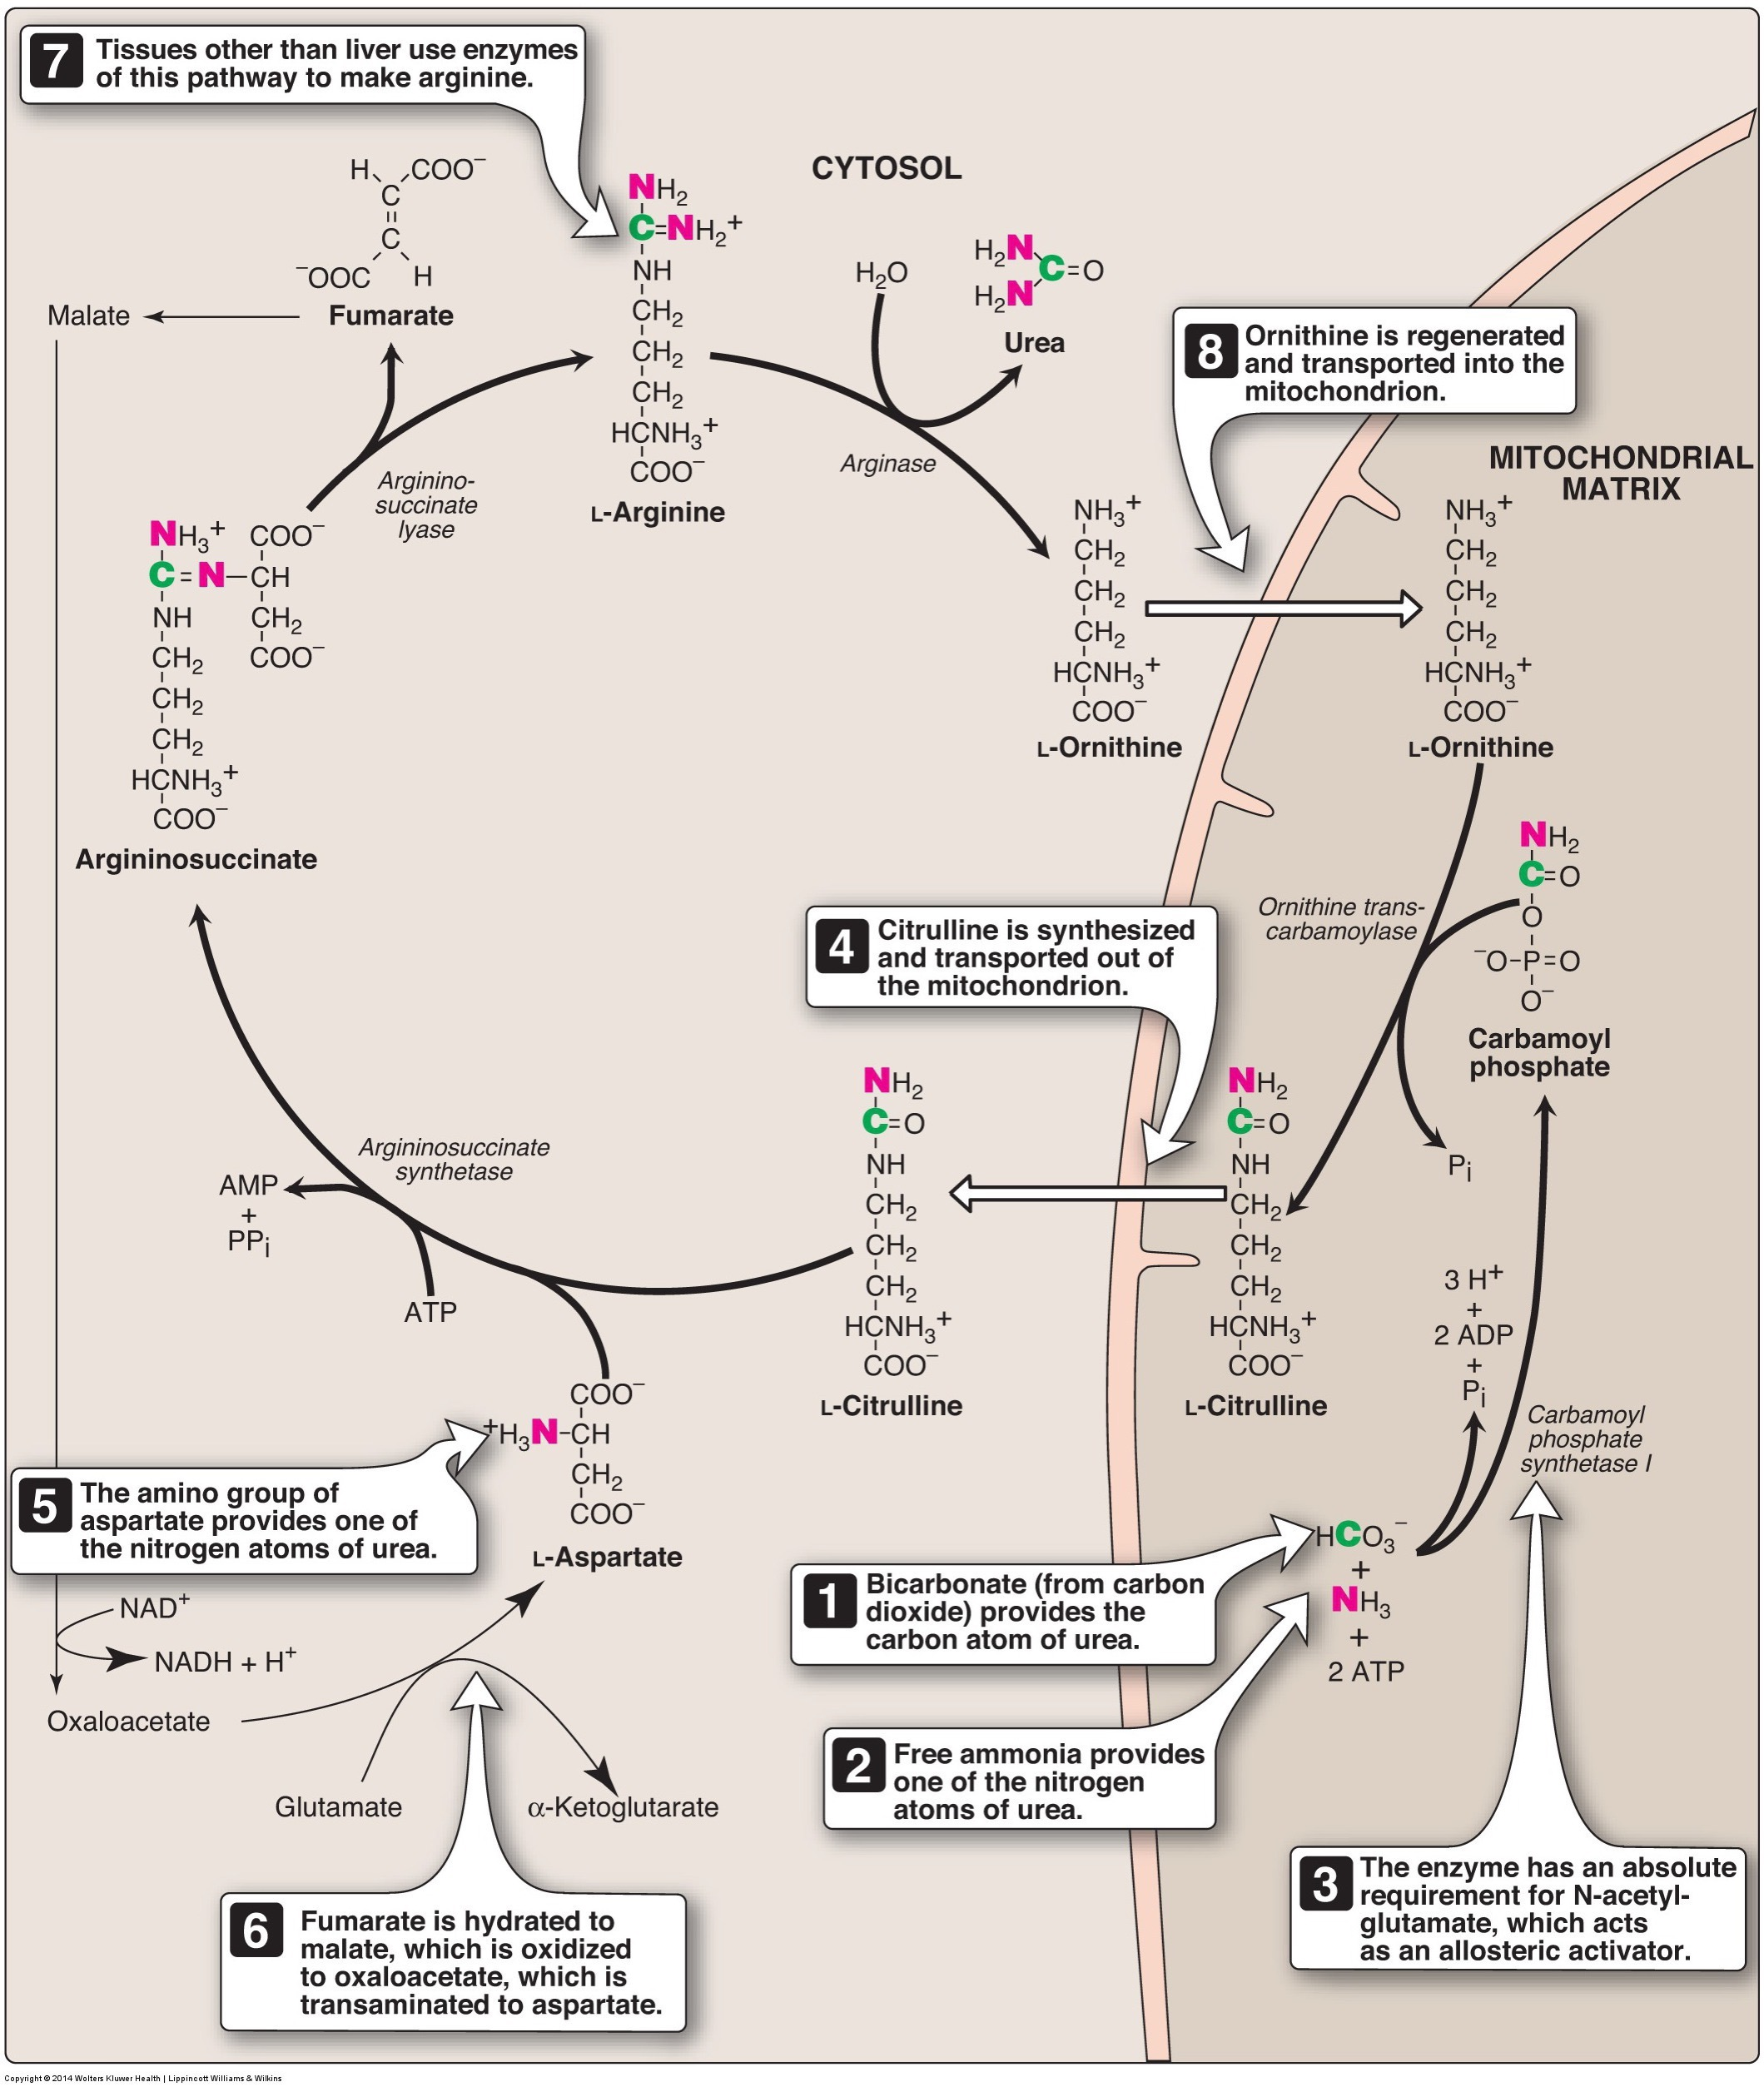
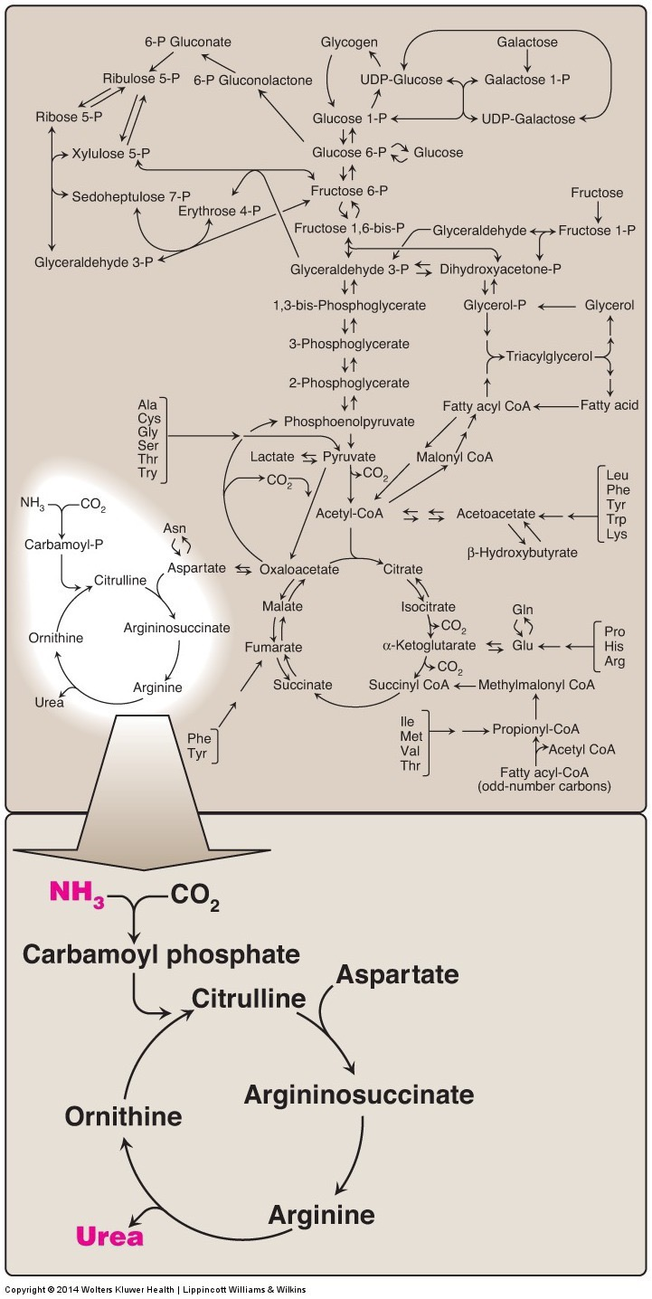
The Urea Cycle converts toxic ammonia into urea for excretion
Notes:
Uses 3 ATP to convert 1 ammonia to 1 urea

Slide 27
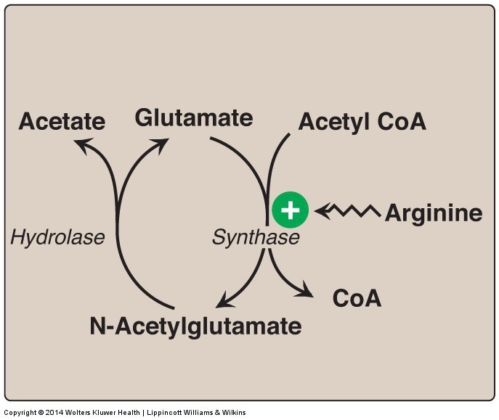
The Urea Cycle is Regulated by N-Acetylglutamate (NAG)
Activates carbamoylphosphate synthetase
NAG levels are increased with:
Glutamate
Acetyl-CoA
Arginine
Urea cycle enzymes are also increased by glucagon and glucocorticoids and decreased by insulin

Slide 28
Why would glucagon and glucocorticoids want to increase the urea cycle?

Slide 29
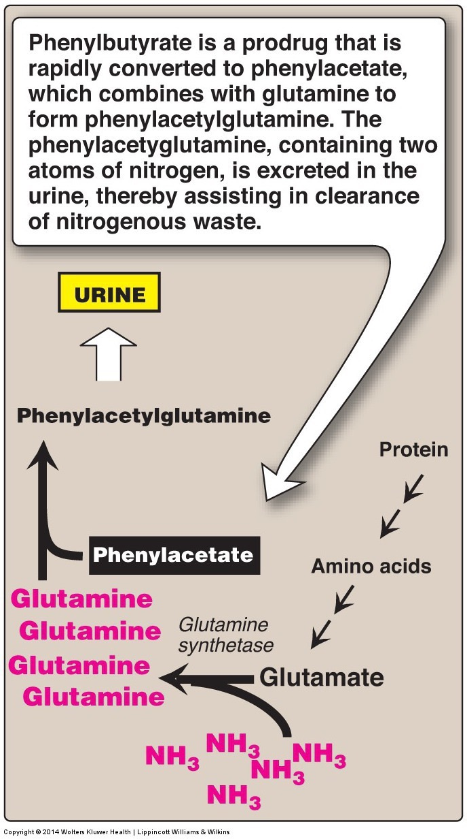
Defects in the Urea Cycle
Acquired: Alcoholic or viral liver diseases
Inherited: Could be any of the various enzymes of the cycle
Most common genetic defect is ornithine transcarbamylase:
X-linked 1:60-75 000
Symptoms include
Hyperammonia
Hyperargininemia

Slide 30
Degradation of the Carbon Skeletons

Slide 31
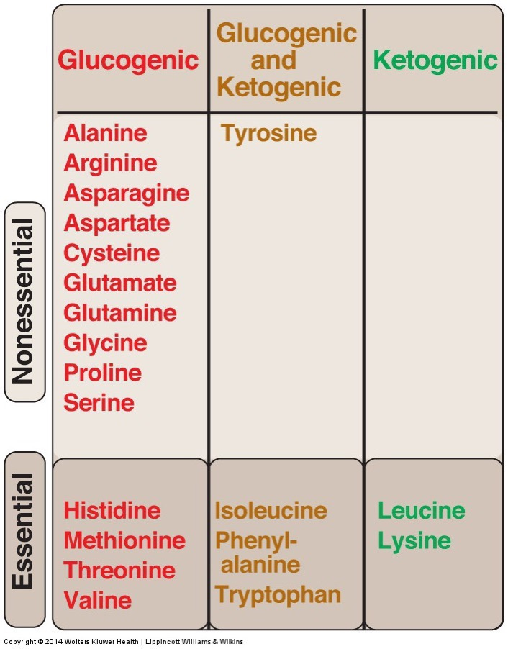
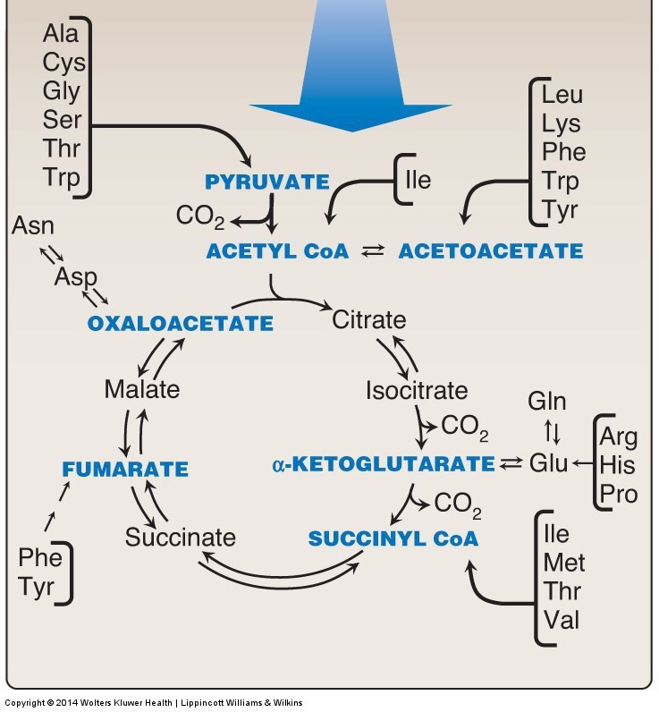
Glucogenic and Ketogenic

Slide 32
Learning Objectives
Describe the processes of proteolysis and autophagy which both lead to the degradation of proteins into amino acids
Understand which hormones, and which internal signals can promote protein degradation
Explain the biochemical basis which underlies whether amino acids are glucogenic or ketogenic
Understand the role that the Urea Cycle plays in metabolizing ammonia during amino acid catabolism

